Slide 1
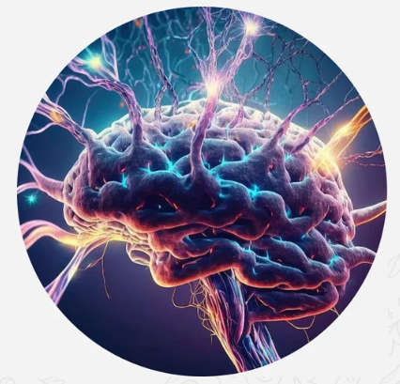
IFA Neuroscience (IFANeuro): TOE Neuroscience (TOENeuro)
Tijani Mustapha Abiodun Adedeji
CENProject

Slide 2
Agenda
Introduction to Ifa
Motivation
IFA Mathematics: The Standard Model of Mathematics
IFA Technology (iTOE)
IFA Neuroscience: The Standard Model of Neuroscience
Potential Applications of IFANeuro
Conclusion

Slide 3
Introduction to Ifa: The Ancient Communication Technology
Ifa is the Voice of Olodumare, the Supreme God in Yoruba culture (Isese), Nigeria (Abimbola, 1968; Falola & Olupona, 1991; Adeyemi et al., 2023)
Also called Ifa, the Odu Ifa means the Ifa Code in English
There are 256 Ifa Codes (Apola Odu) in total: 16 Major Codes (Oju Odu) and 240 minor codes (Amulu odu) (Abimbola, 1968)
Ifa is the Oracle: The Odu Ifa is an ancient communication technology far ahead of modern technologies
The Odu Ifa System: Also called the Ifa Coding System, the Odu Ifa System is defined as the Ifa Code together with Ifa objects, such as the divination tray (opon Ifa), sacred palm nuts (ikin Ifa), cowries, kolanut, seashells, iroke Ifa (tapper), and other items used for consultation.
The Mathematics of the Odu Ifa is Ifa Mathematics (TOE Mathematics)
Developed in CENProject, Ifa Mathematics is the Base Discipline or Universal Meta-Discipline containing all other fields and disciplines of knowledge
Ifa is based on the Orisha Philosophy (TOE Philosophy)
Ifa is the ancient Theory of Everything (TOE) built by Orunmila

Slide 4
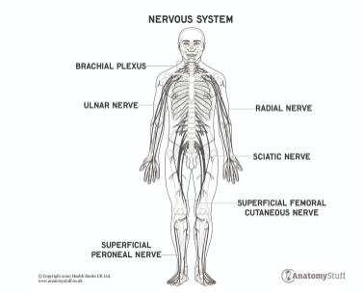
Motivation
Currently, all fields and disciplines of knowledge are characterized by fragmentation and silos lacking a single, unifying framework.
But the world’s key problems are now complex and interconnected, and solutions to them won't come from a single specialism or subject.
Hence, integration of all fields and disciplines is needed now more than ever.
Neuroscience as of today is still a young field and lacks a unifying framework integrating all its subfields together, just like all other fields lack such a universal framework.
Due to this gap in knowledge, scientists are not able to understand the brain at the most fundamental level and successfully tackle the mysterious nature of consciousness
Without such an understanding, it is impossible to unify and integrate all fields of knowledge.
Consequently, scientists have not been able to find a cure for many, if not all, mental and brain disorders
These are what motivated the development of IFA Mathematics and its key element, IFANeuro.
The Human Nervous System: An INTERNETworked System

Slide 5
Motivation
In nature, there are many other interconnected and internetworked systems, and key examples are the nervous systems of other animals.
Each part or component of these nervous systems works harmoniously to coordinate various physiological processes and enable the organisms to interact with their environment.
Such unity, harmony, and synergy is what we aim to achieve among all fields and disciplines with the TOE built based on the Odu Ifa.
Such a high-level integration of knowledge will bring about breakthroughs in all spheres of life.
The Horse Nervous System: An INTERNETworked System

Slide 6
Artificial (Man-Made) INTERNETworked Systems: The Internet
According to Peterson & Davie (2012), internetworking involves interconnecting multiple computer networks in such a way that any pair of hosts in these connected networks is able to exchange messages regardless of their networking technology (hardware-level).
In this process, the resulting system of interconnected networks is known as an internetwork, or an internet, simply put (Coulouris et al., 2012).
The Internet is the most popular example of internetworking and is a massive "network of networks” (Peterson & Davie, 2012).
It is a massive global network of interconnected computer networks that enables data services and communication between users via the standard communication protocol suite (TCP/IP) (Heflin, 2015).
Introduction to the Internet: https://youtu.be/GZH47dhqLgM

Slide 7
Ifa Mathematics (IFAMath): TOE Mathematics
This is the scientific study of energies manifesting as all elements of nature, including all fields and disciplines of knowledge (Tijani, 2024).
IFAMath is a tool for internetworking all fields of knowledge together
It unifies, integrates, and interconnects all fields and disciplines together as One.
Ifa Mathematics is Universal Mathematics: the universe of all fields of Mathematics.
It is also Universal Metamathematics: the universe of all advanced fields of Mathematics known as Metamathematics, the Mathematics of Mathematics.
IfaMath is the Base Discipline and is defined as Energy (CEN or Ogbe) represented with Ifa Infinity (Double Infinity), while all fields and disciplines are its simulations (based on Ifa Simulation Theory).
Hence, the elements of Ifa Mathematics are all fields and disciplines of knowledge.
Ifa Numbers and Ifa Algebras are key universal meta-structures in IfaMath.
Ifa Mathematics is also called Consciousness Mechanics.

Slide 8
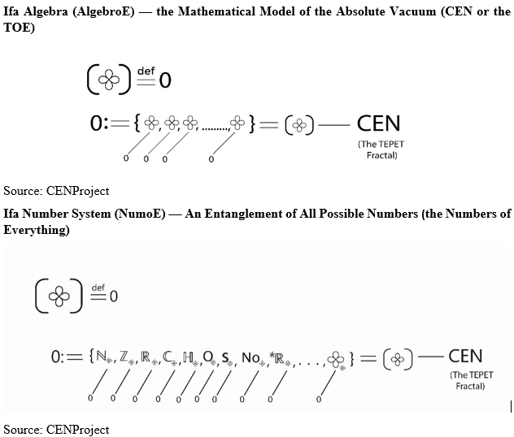
IFAMath: Ifa Numbers and Ifa Algebras

Slide 9
IFAMath: The Odu Ifa

Slide 10
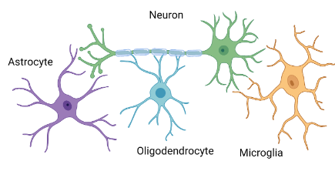
Introduction to Neuroscience
Neuroscience is the scientific study of the brain.
The human brain contains 86 billion neurons (8.6 x 1010) (King’s College London [KCL], 2025).
Neuroscientists are professionals, who investigate how these neurons connect with each other and with other parts of the nervous system as well as the rest of the body (KCL, 2025).
Neuroscience is the scientific study of the nervous system, its functions, and its disorders (KCL, 2025).
The nervous system comprises the brain, spinal cord, and peripheral nervous system (that part of the nervous system that lies outside the brain and spinal cord).
The nervous system is a complex network of nerves, the brain, and the spinal cord that controls how the body works.
Also called Neural Science, Neuroscience is a multidisciplinary science combining physiology, anatomy, molecular biology, developmental biology, cytology, psychology, physics, computer science, chemistry, medicine, statistics, and mathematical modeling (Kandel, 2012).
The aim is to understand the fundamental and emergent properties of neurons, glia, and neural circuits (Kandel, 2012).
Source: https://bpsbioscience.com/

Slide 11
Introduction to the IFA Technology
Also known as the IFA Tech, the Internet Model of the Theory of Everything (iTOE) is the Theory of Everything developed in CENProject unifying and integrating all fields together (iTOE, 2024)
Simply called IFA, it is based on the Odu Ifa and other African Indigenous Knowledge Systems (AIKS)
IFA is the Universal System, which is the unique solution to the grand problem of developing the Theory of Everything (TOE) in Physics (iTOE, 2024a).
The TOE, which has been an open problem in physical science for decades, seeks to provide a holistic and comprehensive model of the Universe unifying the whole of Physics together (iTOE, 2024a)
IFA is the universal meta-model of the Internet based on the Odu Ifa combined with the Internet Model, Internet of Things (IoT), and Internet of Everything (IoE) in Computer Networking (Tijani et al., 2024).
It is the Internet of Internets: In this Tech, we use Ifa numbers and Ifa algebras to model all fields as knowledge networks (mathematical structures), with all the fields made to “talk” to one another in Ifa Language within the TOE.
IFA is an extension and new generation of the Web (WWW) and is developed specifically for the TOE Discipline and Projects (iTOE, 2024).
Ifa Mathematics is the Universal Constructor of all elements of this Tech.
Introduction to iTOE: https://www.youtube.com/watch?v=TfkEBb7QYeY
IFA Neuroscience (IFANeuro) is a key element of the IFA Technology.

Slide 12
IFA Neuroscience
Also called TOE Neuroscience, is the new discipline developed in CENProject as the unifying framework of Neuroscience as a whole, which is the science of the brain and the nervous system.
Ifa Neuroscience is developed based on the Odu Ifa combined with modern science.
This approach to Neuroscience involves studying the discipline focusing on its core or essence, i.e., its Energy called Consciousness Energy (CEN).
IFANeuro is the spirit or consciousness of Neural Science, lying within the larger discipline IFA Science (TOE Science) -- the Science of Everything (SoE).
SoE is the core sciences of the Odu Ifa.
TOE Neuroscience, also called TOENeuro, is a key element of the Universal System built in CENProject called the Theory of Everything (TOE), unifying all fields and disciplines together.
Ifa Neuroscience, as a meta-field of Ifa Mathematics, is studied using Ifa numbers and Ifa algebras and is the universe of all theories and models in Neuroscience.
IFABits (TOEBits), i.e., Vacuums (CENBits), are the building blocks of this neuroscientific universe.

Slide 13
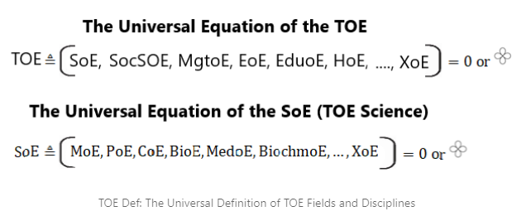
IFA Neuroscience: It Is All about Making Connections
TOENeuro is also called the Neuroscience for Everything (NeuroE), which is the unifying framework for the field as a whole interlinked and internetworked with all other fields and disciplines within the IFA Technology.
IFANeuro is an Ifa tech on its own for exploring the interconnectedness of all neuroscientific theories and models and lying within much bigger Internet, iTOE.
The Universal Definition of all fields and disciplines in the TOE, known as TOE Definition (TOE Def), is given in the meta-equations below:

Slide 14
IFA Neuroscience: A Meta-Field of IFAMath
Unlike Neuroscience as it is studied today in the mainstream science, Ifa Neuroscience is a meta-field of Ifa Mathematics.
In TOENeuro, we model Neuroscience as a mathematical structure using Ifa Numbers and Ifa Algebras.
There are tons of theories and models of Neuroscience, which are used to study the cellular, functional, behavioral, evolutionary, computational, molecular, cellular, and medical aspects of the nervous system.
These are various subfields of Neuroscience, but they often overlap as very few principles underlies all theories, models, and subfields of Neuroscience.
It is these principles we call the TOE, which is Energy (CEN) as outlined in the TOE Axioms (Ifa Axioms)
Hence, Ifa Neuroscience is the scientific study of themes, patterns, or principles that are common to all theories and models of Neuroscience.

Slide 15
IFA Neuroscience: The Axioms of Neuroscience
We define Neuroscience in the concise and precise language of Ifa Mathematics (TOE Mathematics) as a form of Energy represented by Ifa Infinity, which is Double Infinity (Duoinfinity) also depicting the TOE.
We also adopt this same definition called TOEDef universally for any theory, model, principle, concept in Neuroscience
By using TOEDef, we ensure the field as a whole is studied with a universal language called Ifa Language (Ifa Lang), thereby unifying and integrating the whole of Neuroscience together and internetworking and interlinking it with all other fields and disciplines within the TOE, which are also defined as a form of Energy
Using this Approach called Ifa Approach or TOE Approach via Ifa Lang, which is also known as CEN Language or TOE Language (TOEL), we unify all theories and models in any particular field or discipline
We also unify all fields and disciplines together as a whole using the same Universal Language.

Slide 16
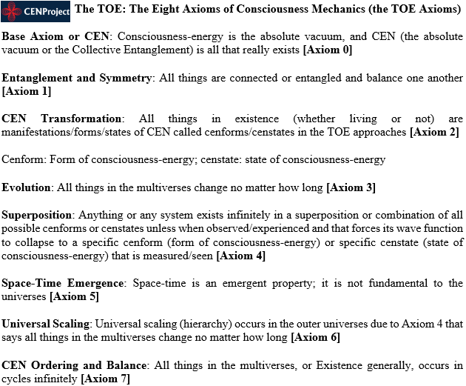
IFA Neuroscience: The Axioms of Neuroscience

Slide 17
Ifa Neuroscience: The Standard Model of Neuroscience
In the TOE, we model the brain and the mind as mathematical structures using Ifa Mathematics, Category Theory, Categorical Logic, Universal Algebra, Type Theory, Model Theory, and Network Theory.
Neuroscience, as a whole, is a meta-field of Ifa Mathematics, also referred to as Consciousness Mechanics, meaning we treat Neural Science as a mathematical structure or object modelled using Ifa objects.

Slide 18
Ifa Neuroscience: Ifa Brain, Classical Brain, and Quantum Brain
The Classical Brain Model
The traditional, widely accepted model of brain function is based on Classical Physics and Neuroscience principles.
Classical Physics: The Physics of the macroscopic world.
In simpler terms, the classical brain is the brain we see with the naked eye.
Neuronal Computation: The brain functions like a highly complex biological computer, with neurons transmitting signals through electrochemical processes.
Limitations of the Classical Brain Model:
It struggles to explain subjective experience (the "hard problem" of consciousness).
It may not account for the brain's extreme efficiency compared to classical computers.
Certain cognitive processes, such as insight, creativity, and free will, remain difficult to model purely in classical terms.

Slide 19
Ifa Neuroscience: Ifa Brain, Classical Brain, and Quantum Brain
The Quantum Brain Model
This model suggests that quantum mechanical effects—such as superposition, entanglement, and wave function collapse—may play a role in cognition and consciousness (Jedlicka, 2017).
Based on Quantum Physics and Neuroscience principles
Some quantum brain models suggest the brain functions like a quantum computer (Aishwarya et al., 2020).
Quantum Physics: the Physics of the microscopic (subatomic) world.
Quantum Coherence in the Brain: Some researchers such as Hameroff & Penrose (2014) propose that quantum effects in microtubules (Penrose-Hameroff Orch-OR theory) or ion channels could influence neural processing.
Superposition & Parallel Processing: The brain processes multiple possibilities simultaneously before collapsing into a definite state (Hameroff & Penrose, 2014)
Quantum Entanglement & Nonlocality: Information processing in the brain could involve nonlocal connections, which might explain phenomena, such as intuition or psi experiences.
Consciousness as a Quantum State: Some models like Penrose-Hameroff Orch-OR theory suggest that consciousness arises from quantum wave function collapse rather than classical computation (Hameroff & Penrose, 2014).
Challenges of the Quantum Brain Model:
Lack of Empirical Evidence: There is no direct experimental proof as of yet confirming quantum computation in neurons.

Slide 20
Ifa Neuroscience: Ifa Brain, Classical Brain, and Quantum Brain
Ifa Brain: The TOE Brain Model
This is the universe of all brain models in Neuroscience, encompassing classical models, quantum models, and others.
Ifa Brain is the container and fundamental building block of all theories and models of the brain in Neuroscience.
Ifa Brain is the universal meta-model of the brain, where the Ifa Code (i.e., Vacuum, Energy, Ogbe) is the building block of the brain and everything in existence.
Here, we regard the soul, which is Energy (CEN) or Vacuum, as the brain code.
Specifically, we mean that the Universal Binary Code (single and double lines of Ifa), i.e., the Odu Ifa (Ifa Code), is the codes that make the brain function.
The 256 universal meta-codes of Ifa, especially the Ifa Pair (single and double lines of Ifa), are everything that really exists at the most fundamental level, which is why we use them to define the brain, and its dual, the mind.
Monod (1974) said, “anything can be reduced to simple, obvious mechanical interactions. The cell is a machine. The animal is a machine. Man is a machine”.
In Ifa’s Model of reality, man is a living machine (biomachine) built with Ifa Codes via manipulation of Energy (Ogbe or Vacuum) in a process called Ifa Programming, Universal Meta-Programming.
Evolution of the Brain from Vacuum (Ogbe or Energy): Vacuum → Quantum Brain → Classical Brain

Slide 21
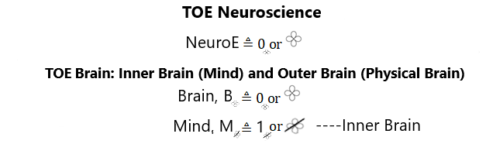
Ifa Neuroscience: Ifa Brain, Classical Brain, and Quantum Brain
From TOEDef, the universal definition in the TOE for all subfields, theories, and models of Neuroscience, we define the brain as a form of Energy (CEN), and the mind as the dual or opposite of the brain.
In other words, the mind is the inner brain, which is the non-physical brain, while the brain is the physical manifestation of the mind that we can see with the naked eye.
Thus, the brain emerged from the mind contrary to the opinion of many neuroscientists.
Here, we apply Axiom 1 in the Eight TOE Axioms shown below and the duality principle in Mathematics.

Slide 22
Applications of IFA Neuroscience
Applying the Ifa Model of the Brain, IFA Computers (TOE Computers), which are Computers for Everything (ComputoE) much advanced than quantum computers, can be built. The human brain, Nature (the Universe) are examples of ComputoEs, universal meta-computers.
Among many other potential applications, TOENeuro reveals the core or essence of Neuroscience as Energy, giving us a bird's eye view of the whole field interconnected and internetworked with all other fields and disciplines.
This allows us to understand the brain at the most fundamental level and develop the cure or better treatment for mental and brain disorders.
It enables to gain a deeper understanding of neurodiversity/neurodivergence, autism, schizophrenia, and related issues.
By understanding the brain at the most fundamental level with IFANeuro, we can build Ifa Psychiatry as the Standard Model of Psychiatry, allowing the discovery of cure or better treatments for mental and brain disorders.
Ifa Psychiatry, also known as TOE Psychiatry, also provides a deeper understanding of neurodiversity/neurodivergence, autism, schizophrenia, and related issues.
Ifa Psychiatry is the next discipline to be examined.

Slide 23
Conclusion
Neuroscience is the scientific study of the brain.
Also called TOE Neuroscience, is the new discipline developed in CENProject as the unifying framework of Neuroscience as a whole, which is the science of the brain and the nervous system.
Ifa Neuroscience is developed based on the Odu Ifa combined with modern science.
This approach to Neuroscience involves studying the discipline focusing on its core or essence, i.e., its Energy called Consciousness Energy (CEN).
IFANeuro is the spirit or consciousness of Neural Science, lying within the larger discipline IFA Science -- the Science of Everything (SoE).
TOE Neuroscience, also called TOENeuro, is a key element of the Universal System built in CENProject called the Theory of Everything (TOE), unifying all fields and disciplines together.
Ifa Neuroscience, as a meta-field of Ifa Mathematics, is studied using Ifa numbers and Ifa algebras and is the universe of all theories and models in Neuroscience.

Slide 24
Thank you
Many thanks to our sponsors. Please, support our work by donating to Tijani Mustapha 3095032499 First Bank (via Send wave or local transfer in Nigeria)

Slide 25
References
Adeyemi S. O., James, A., Emmanuel, O. A., & Folake, L. J. (2023). Algebraic characterization of Ifa main divination codes. Scientific African, 20, e01729–e01729. https://doi.org/10.1016/j.sciaf.2023.e01729
Abimbola, W. (1968). “Ifa as a Body of Knowledge and As an Academic Discipline”, Lagos Notes and Records. vol. 2, no. 2. 1968. pp. 30-40)
Aishwarya, S., Abeer, V., Sathish, B.B. & Subramanya, K.N. (2020). Quantum computational techniques for prediction of cognitive state of human mind from EEG signals. J. Quantum. Comput. 2(4):157–70.
‌Coulouris, George; Dollimore, Jean; Kindberg, Tim; Blair, Gordon (2012). Distributed Systems: Concepts and Design. Addison-Wesley.
Falola, T., & Olupona, J. K. (1991). African Traditional Religions in Contemporary Society. The International Journal of African Historical Studies, 24(2), 417. https://doi.org/10.2307/219809
Hameroff, S. & Penrose, R. (2014) Consciousness in the Universe: A Review of the “Orch OR” theory, Phys Life Rev., 11, pp. 39–78. https://doi.org/10.1016/j.plrev.2013.08.002
‌Heflin, K. (2015). The Internet Is Not the Antidote. Journalism History, 41(3), 165–175. https://doi.org/10.1080/00947679.2015.12059127
Jedlicka, P. (2017). Revisiting the Quantum Brain Hypothesis: Toward Quantum (Neuro)biology? Frontiers in Molecular Neuroscience, 10. https://doi.org/10.3389/fnmol.2017.00366
King’s College London (KCL) (2025). What is neuroscience? https://www.kcl.ac.uk/neuroscience/about/what-is-neuroscience#
Kandel, Eric R. (2012). Principles of Neural Science, Fifth Edition. McGraw-Hill Education
Monod J. (1974). “BBC lecture,” in Beyond Chance and Necessity, ed. Lewis J. (London: Garnstone Press
Peterson, L. L.; Davie, B. S. (2012). Computer Networks: a systems approach. Elsevier, Inc.
The Internet Model of the Theory of Everything (iTOE) (2024). The Internet Model of the Theory of Everything (iTOE). CENProject. https://toe.cenproject.org/
The Internet Model of the Theory of Everything (iTOE) (2024a). Building the Internet Model of the Theory of Everything (iTOE) Version 0.1. CENProject. https://toe.cenproject.org/building-the-internet-model-of-the-theory-of-everything-itoe-version-0-1/
Tijani, M. A. (2024). Consciousness Mechanics: Generalized Mechanics. OSF Preprint. https://doi.org/10.31219/osf.io/xarn8
Tijani, M. A., Olubanjo, K. T., Quadri, T., Fiyinfoluwa, O., Olalekan, O. T., Habeeb, A. O., IBIROGBA Damilola Akolawole, OBE Kehinde Daniel, EMMANUEL Blessing Nkechi, SIMON Ojoma Glory, IHEANACHO Blessing Ejitu, DANJUMA Ibrahim Dazeen, OLAOLUWA John Adeleke, OJO Ige Rachael, & Malik, M. O. (2024). The Internet Model of the Theory of Everything (iTOE): A New Approach to Developing the Theory of Everything (TOE) in Consciousness Science (iTOE, Version 0.1 — A CEN Technology). OSF Preprint. https://doi.org/10.31219/osf.io/wmqet

